Slide 1

SDEV 1701
Lesson16: Colour Theory for the Web

Slide 2
INTRODUCTION TO COLOUR PSYCHOLOGY

Slide 3
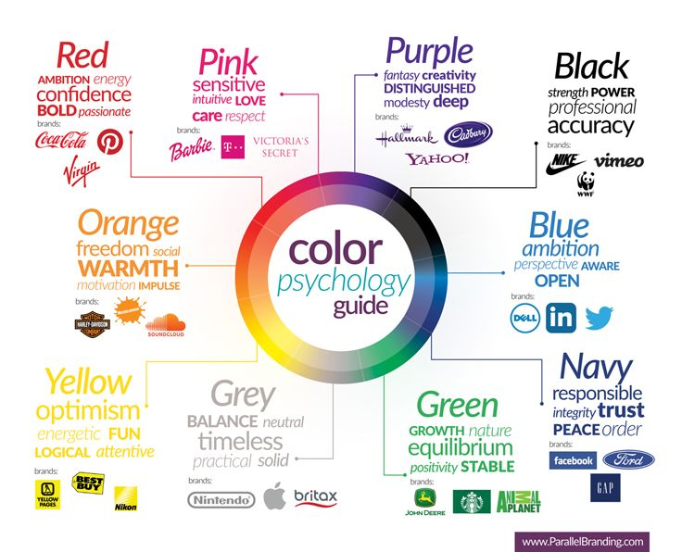
PSYCHOLOGY OF COLOUR
We usually divide colours into two groups: warm and cool.
Warm shades, such as red, orange, and yellow, resemble a crackling fire or a bright sunset; they fill us with energy and enthusiasm.
Cold shades - blue, green, purple - are associated with a calm lagoon or a quiet forest, bringing a feeling of calm, relaxation and peace.
Notes:
The retina of the human eye, which is very sensitive, receives information about the reflected rays, after which the read information is transmitted through the optic nerve to the occipital part (to the center of visual perception). The information that we receive from an object is not color, but contrast. And any object that we see does not have color, but reflects light.

Slide 4
PSYCHOLOGY OF COLOUR IN UX/UI
Research and testing are the guiding stars of effective design, but here's the catch: while the fundamental principles of colour psychology remain the same, their interpretation can be deeply personal and vary depending on culture, age, and other such factors.
When choosing colours, designers often fall victim to their own biases and preferences. This is natural, because at the end of the day, we are all human. However, we must remember that our job is to convey a message and evoke emotions, not just create something that seems aesthetically pleasing to us.

Slide 5
PSYCHOLOGY OF COLOUR IN UX/UI
Designer ≠ client. Always remember this. Be guided by empathy and the goals set before you, put aside your own tastes and try to truly understand the needs and desires of the target audience.
But here’s where the complexity comes in: stakeholders, from product managers to CEOs, also bring their own palette of biases to a project. And sometimes those biases are about colour. I’ve been in meetings where decisions were made based on such personal preferences.
In this situation, our only recourse is user testing. Empirical data can show that while the CEO’s granddaughter loves neon pink, it’s far from the most effective choice for an important CTA button in a banking app.

Slide 6
PSYCHOLOGY OF COLOUR IN UX/UI
Another danger is using too many colours. Remember that moderation is the key to success. The most impressive designs I have seen have a limited colour palette. This approach makes the product more focused and understandable.
Too many colours can confuse the user, blur the main message, and cause cognitive overload. Think of seasonings: a pinch of salt enhances the flavour, but too much can ruin the dish. The same applies to colour: shades should be used selectively, with a clear understanding of the role and impact of each.

Slide 7
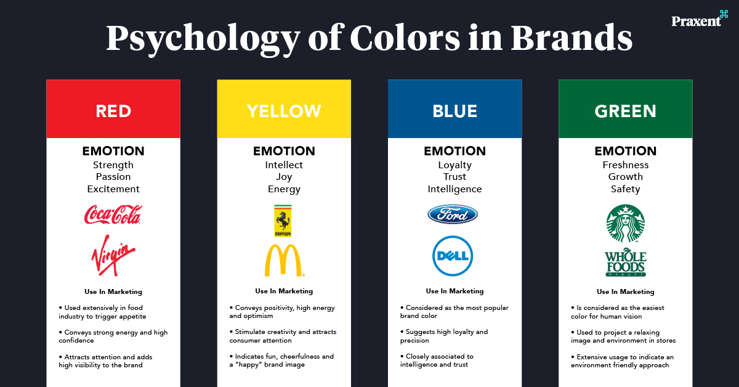
Psychology Of Colour in UX/UI
When we delve into the world of colours, it’s like we’re exploring an atlas of emotions. Understanding the emotional geography of warm and cool colours helps designers and marketers create experiences that resonate with their audiences.

Slide 8
PSYCHOLOGY OF INDIVIDUAL COLOURS

Slide 9
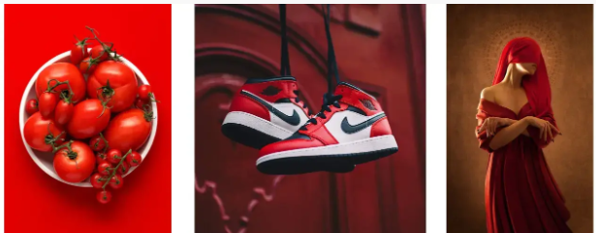
RED
Red is a powerful colour that can make a splash. It speaks the language of love and passion, pulsating with energy.
It can also evoke anger and aggression, and is often used as a signal of danger.
In design, red can be a reliable marker, emphasizing urgency or highlighting key elements of a page.

Slide 10
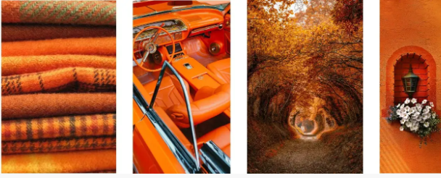
ORANGE
Orange is energetic and warm, with a creative spark and a zest for life.
It is uplifting and comforting, making it a popular choice for food and beverage branding.
It is your choice if you want to make your designs more playful and uplifting.

Slide 11
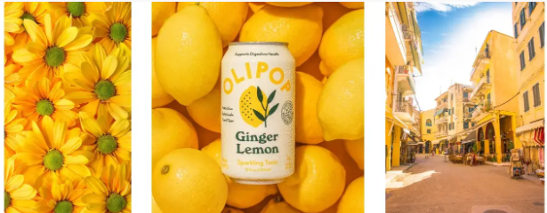
YELLOW
Yellow is a bright, sunny colour filled with joy, happiness, and positivity.
At the same time, we can find it in various warning signals and signs (for example, traffic lights, “Electric voltage”), prompting us to act more carefully.
Include yellow in your design to add a note of optimism or highlight important information.

Slide 12
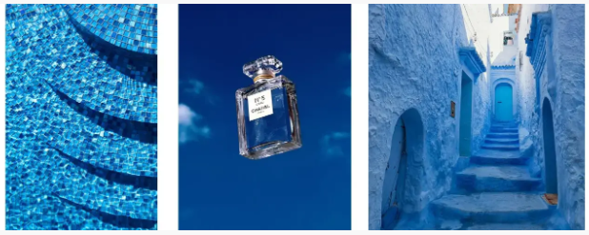
BLUE
Picture a serene sky or the sea. Blue is a calming colour that is often associated with trust, loyalty, and stability.
But like a cloudy day, sometimes shades of blue can evoke sadness or melancholy.
This colour is often found in the health and recreation industries, as it promotes relaxation and reduces stress.

Slide 13

GREEN
Green is the embodiment of Mother Nature. It is refreshing and calming. It is a symbol of growth, harmony and balance.
Green plays an important role in the branding of financial companies and eco-friendly businesses, because it conveys growth and caring attitude towards the environment.
This is exactly what you need if you want to create a refreshing atmosphere and emphasize the naturalness of your product.

Slide 14
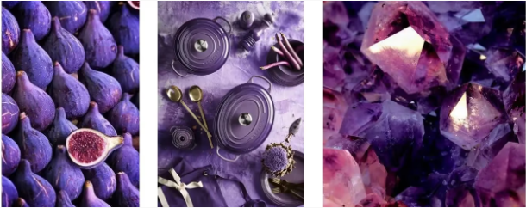
GREEN
Purple is the colour of royal robes and lavender fields.
It speaks of luxury and royalty, is associated with creativity, spirituality and wisdom, but can seem mysterious and ambiguous.
It is often found in the design of cosmetic and fashion brands.
Purple adds sophistication to the design and creates a sense of exclusivity.

Slide 15
COLOR COMBINATIONS

Slide 16
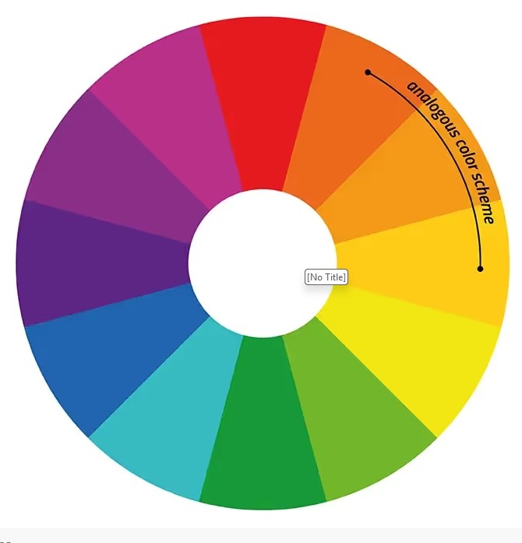
Analogous color scheme
An analogous colour scheme is a combination of colours that are adjacent on the colour wheel. These palettes bring unity and harmony to a design, creating a calming, cohesive visual experience.
The charm of analog schemes lies in their balanced, pleasant aesthetics. With the help of soft colour transitions, we can maintain a certain mood and a consistent visual identity of brands or products.

Slide 17
Analogous color scheme
Imagine a website for a manufacturer of camping equipment in shades of blue and green, referencing the serene beauty of nature and awakening a thirst for adventure.
Or a fashion brand filled with youthful energy, in rich orange, red and yellow shades.
Such a palette will definitely resonate with the bright self-expression of the target audience.
*However, remember that analog circuits offer limited colour contrast, so you need to be especially careful about readability and accessibility.

Slide 18
Analogous color scheme
Analog palettes are great for dashboards. Here's how to use them:
Mood Trackers: Each colour can symbolize a different mood, allowing you to quickly recognize and track emotions.
Meditation and stress management: Calming shades of blue and green help you relax and get in the right frame of mind.
Habit Trackers: Gradually changing colours show you the various stages of your goal achievement. This is a visual reward for your progress.

Slide 19
Analogous color scheme
Financial analytics: Warm colours can symbolize income, while cool colours can symbolize expenses. This will help users scan their financials faster.
Social Activity: Use warmer analogous colours to indicate high levels of engagement, such as likes or comments, and cooler colours for less active interactions.

Slide 20
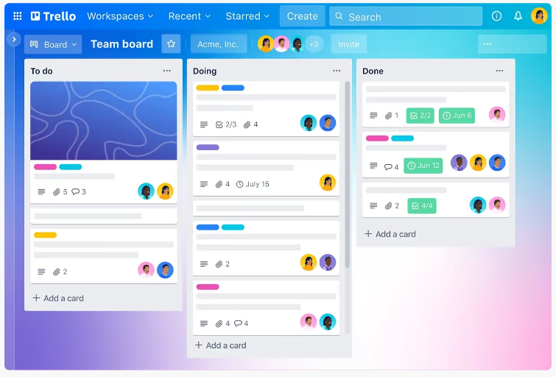
Examples
Trello, a project management tool that makes effective use of an analogous colour scheme with different shades of blue. It creates a holistic, calming visual experience, perfectly reflecting the platform’s goal of helping people organize their work and increase productivity.
Analogous colours serve as markers to differentiate between lists and cards, making it easier to manage tasks.

Slide 21
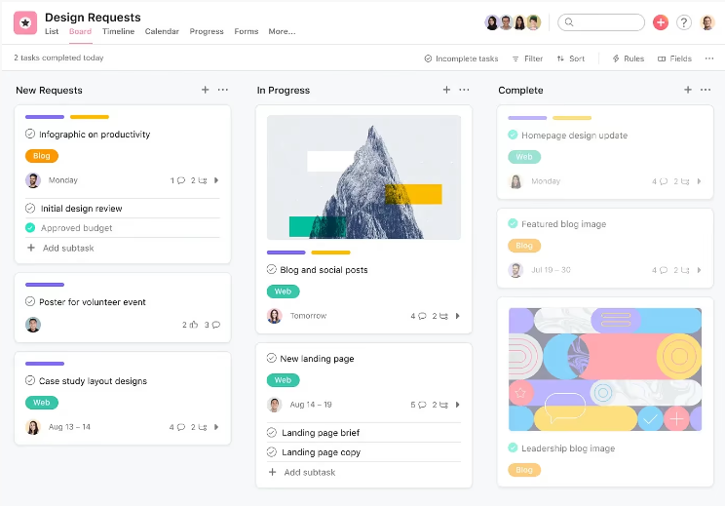
Examples
Asana , cleverly uses an analog scheme with shades of orange and yellow. These warm, vibrant colours create an optimistic atmosphere that increases user engagement and motivation. As in the previous example, analog shades help differentiate projects, tasks, and statuses.

Slide 22
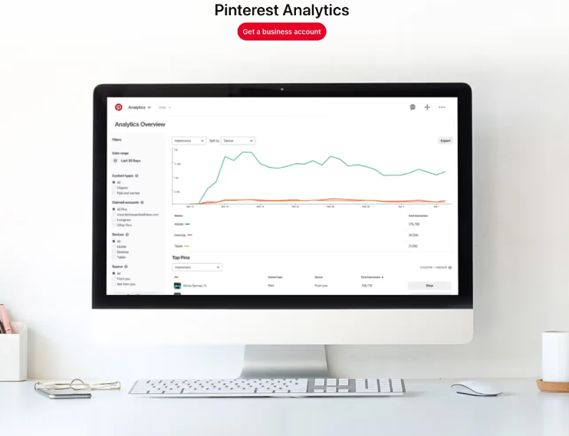
Examples
Pinterest Analytics . The analogous colour scheme here is made up of bright shades of red and pink. These colours are creative, inspiring, and uplifting, which is perfect for the platform’s purpose (visual exploration and idea sharing). Analogous colours represent different metrics and insights, making it easy to track the effectiveness of your content.

Slide 23
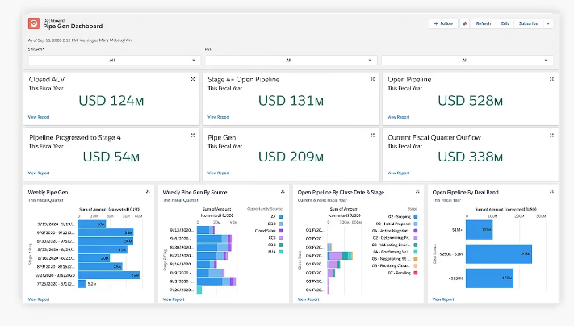
Examples
Salesforce, a leading CRM platform that effectively uses an analog scheme with shades of blue and turquoise. This colour combination inspires trust, professionalism, and efficiency. Analogous colours help users navigate the various modules and sections of the dashboard.

Slide 24
Complementary color scheme
A complementary colour scheme is a combination of colours that are opposite each other on the colour wheel. Classic duos like red and green, blue and orange, or yellow and purple immediately come to mind. These combinations look dynamic and contrasting.
Complementary schemes are a powerful weapon! They look impressive, attract attention and make the design not just beautiful, but unforgettable.
Such colour combinations help to build a clear visual hierarchy, for example, important elements can be highlighted in one colour, and secondary ones in a complementary one.

Slide 25
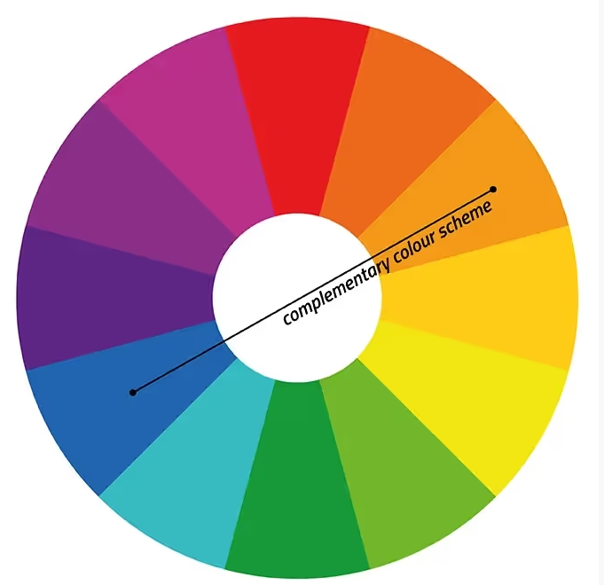
Complementary color scheme
It is important to find the right balance. Use neutral shades or make dominant colours less intense. Your goal is to create an aesthetically pleasing, easy-to-perceive visual.
In addition, complementary colours can cause specific emotional reactions. For example, the combination of red and green simultaneously excites and calms, the combination of blue and orange inspires trust and charges with enthusiasm, and the combination of yellow and purple looks cheerful and luxurious.

Slide 26
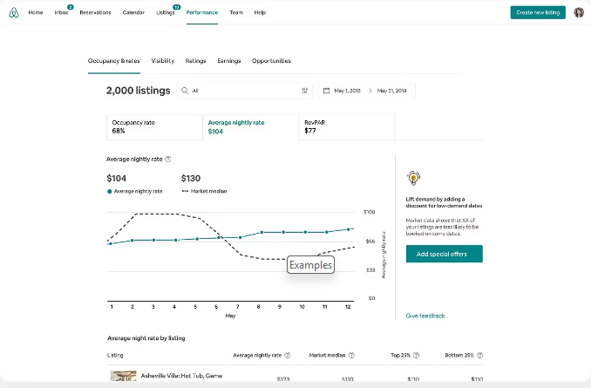
Examples
Airbnb, a world-famous online accommodation booking platform, for example. The company uses a complementary combination of dark turquoise (the primary colour) and coral.
This aesthetic combination exudes reliability, warmth, and hospitality, perfectly reflecting the company's mission, and provides visual harmony.

Slide 27
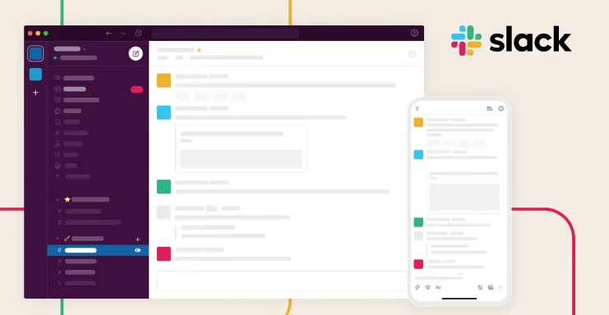
Examples
Slack is a collaboration platform that has taken the corporate world by storm. The primary purple colour contrasts with the vibrant yellow, and this complementary combination is truly pleasing to the eye.
These contrasting colours create a dynamic, attractive interface and convey the core values ​​of the brand - enthusiasm, creativity, and a desire to collaborate.

Slide 28
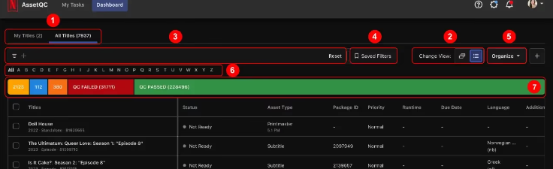
Examples
Netflix . The streaming platform uses a striking combination of red and green on a neutral dark gray background in its branding.
This palette creates a sense of urgency and importance, and is completely in line with Netflix’s commitment to providing audiences with quality entertainment.

Slide 29
COLOUR CONTRAST AND ACCESSIBILITY

Slide 30
Color contrast and accessibility
Think of the different colours on a palette as flavours—some savoury, some sweet—but all integral to a balanced meal. In the same way, colour contrast is the visual difference between colours and a critical factor in creating an engaging, accessible experience that can evoke an emotional response.
Have you ever wondered why some colour combinations work and others don’t? It’s all about contrast.
Not only does it improve the readability of content, making it easier to perceive information, but it also creates a visual hierarchy. It attracts the user’s eye and smoothly leads it through the key elements of the interface.

Slide 31
Color contrast and accessibility
The emotional aspect should not be forgotten either - a strong contrast between warm and cool colours makes the experience lively and energetic, while softer transitions create a calming, serene atmosphere.
Remember that your design should work for everyone, including people with colour blindness. Choose colours with sufficient contrast, test your solutions with special tools, and use additional means of conveying information (such as text labels or symbols) to ensure that your products remain accessible to all users.

Slide 32
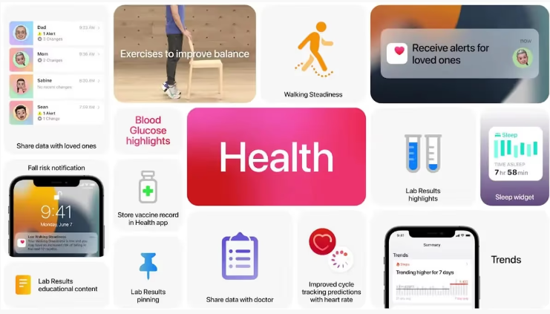
Examples
Apple Health: The platform provides all the tools you need to track your health, from activity and sleep to nutrition. One of Apple’s key design principles is to create an emotional connection with users. And they’ve done a great job of doing this, designing an engaging experience that inspires people to take better care of themselves.

Slide 33
Examples
One of the most striking design elements here is colour. The Apple team carefully selected each shade to evoke the right emotions in users and encourage positive behaviour.
For example, shades of green are often associated with growth, renewal, and vitality. By using it as the main colour, the company gently motivates users to lead a healthier lifestyle and helps them believe in themselves.
In the sections dedicated to sleep and rest, energetic green is complemented by calming shades of blue. This balance creates a pleasant atmosphere for both active activities and relaxation.

Slide 34
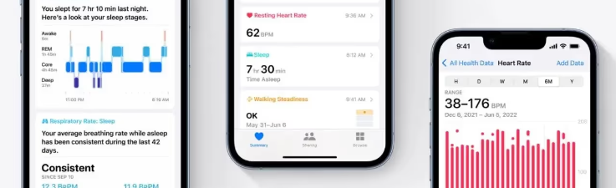
Examples
Apple also highlights strategic elements in red. This bright colour is usually associated with urgency and determination. Here, it highlights metrics that the user can improve, as well as achievable goals. The little red strokes act as calls to action and inspire people to take active steps toward a healthy lifestyle.
Users report feeling more motivated by an emotionally rich, visually appealing interface. And the thoughtful use of colour plays a big role here. It's a great example for any aspiring designer to study.

Slide 35
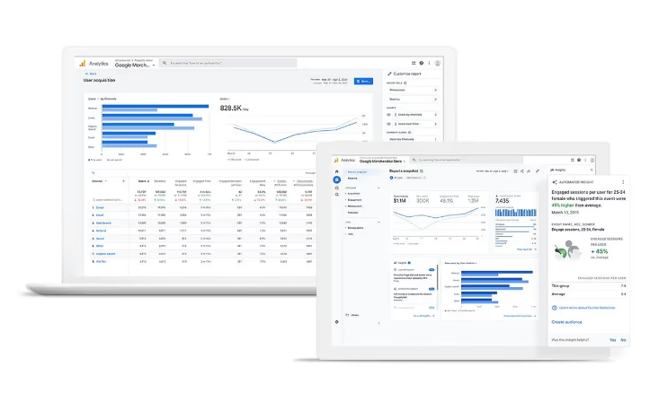
Examples
Google Analytics: Google Analytics is a platform that is very popular among marketers and business owners. It offers a wealth of data on website traffic, user behaviour, and more.
Google’s design philosophy is based on simplicity and ease of use, and the company has really succeeded in turning the process of learning complex metrics into an accessible, informative experience.

Slide 36
Examples
One of the key aspects that makes the product so effective is the clever use of colour. Google uses it to masterfully guide users through the interface and present different types of data in an intuitive way.
Google Analytics' primary colour is a calming shade of blue. Blue, which is typically associated with trust, intelligence, and efficiency, sets the overall tone. It creates a sense of reliability and professionalism, building user confidence in the veracity of the data.

Slide 37
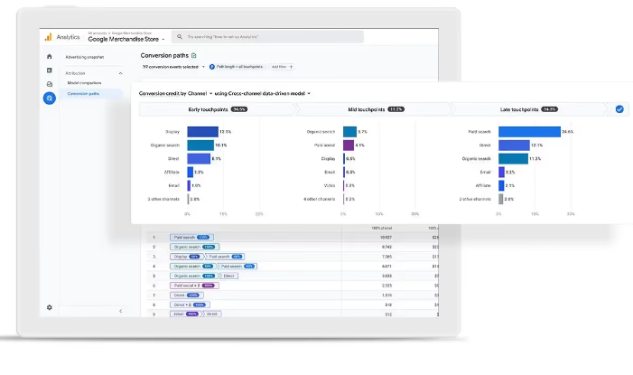
Examples
The bright colours are balanced by the abundance of negative space. It not only makes the interface laconic and neat, but also increases the legibility of the data, bringing colourful graphs and charts to the forefront

Slide 38
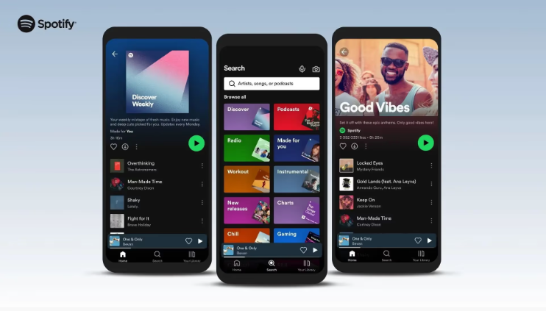
Spotify
Leading streaming platform Spotify provides its users with not only a functional and intuitive, but also an emotional experience. One of the key factors in this success is the right colors.
The brand’s signature color is a calming shade of green. Green symbolizes freshness, creativity, and harmony — a perfect combination for a platform that offers its users a variety of musical experiences. The shade is consistently found throughout the design of all screens, from the logo to various UI elements, creating a holistic visual experience

Slide 39
Spotify
Green is complemented by dynamic colours that depend on the content. When the user plays a song, the dominant colour of the album cover appears in the background. This creates a unique and emotional experience for each song, strengthening the listener's connection with the music and the artist.
Another effective solution is a contrasting combination of light text and dark background. It not only reduces eye strain during prolonged interaction but also helps users navigate the interface.
Spotify also uses colours to categorize and differentiate different sections and features. For example, Spotify-curated playlists are marked with a green logo, while user-created playlists are colored in the dominant colour of the album art. This not only adds personality to the interface but also improves the usability of the platform.

Slide 40
Introduction to WCAG Contrast Guidelines

Slide 41
WCAG (Web Content Accessibility Guidelines) contrast guidelines
WCAG (Web Content Accessibility Guidelines) contrast guidelines ensure that text and images of text have sufficient contrast with their background for readability, especially for users with visual impairments. Specifically, Success Criterion 1.4.3 of WCAG 2.0 requires a contrast ratio of at least 4.5:1 for normal text and 3:1 for large text, and WCAG 2.1 extends this to user interface components.

Slide 42
Key Aspects of WCAG Contrast Guidelines
Contrast Ratio:
The contrast ratio is calculated as the ratio of the relative luminance of the lighter colour to the relative luminance of the darker colour.
Text Size:
Normal text requires a 4.5:1 contrast ratio, while large text (14 point bold or larger) can have a 3:1 ratio.
Colour Blindness:
WCAG guidelines help ensure that content is usable by people with colour blindness by providing enough contrast between colours.

Slide 43
Key Aspects of WCAG Contrast Guidelines
Importance:
Good contrast is crucial for users with low vision, those in difficult viewing conditions (poor lighting, glare), and others who may have temporary or permanent eye issues.
Beyond Contrast:
While contrast is important, WCAG also emphasizes that color should not be the sole way of conveying information, and additional visual cues should be provided.
Conformity Levels:
WCAG 2.0 defines conformance levels (A, AA, and AAA), with AA being the most common target for many websites. AAA provides exceptional accessibility but is not always achievable.

Slide 44
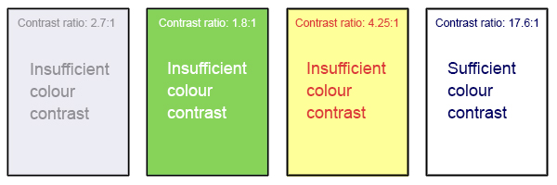
Tools and Resources:
There are many tools available to help calculate and check contrast ratios, such as the WebAIM Contrast Checker
Figma plugins for accessibility

Slide 45
Image Format Overview

Slide 46
Types of images
Web images can be:
Raster (pixel-based) like JPG, PNG, GIF
Vector (math-based) like SVG
.JPG / .JPEG
Raster format: Joint Photographic Experts Group
Great for photographs
Compressed: smaller files, lower quality
Always rectangular/square
No transparency or animation

Slide 47
Types of images
.PNG
Raster format: Portable Network Graphics
Higher quality than JPG (but bigger file size)
Supports transparency & opacity
Great for icons, UI elements, and odd shapes
.SVG
Vector format: Scalable Vector Graphics
Infinite scalability — no pixelation
Code-based, not pixel-based
Transparency & opacity supported
Ideal for: logos, icons,

Slide 48
Types of images
.GIF
Supports animation (multiple frames)
Transparency
Only 8-bit color (256 colors)
Still common for short, looping graphics
.WebP
Modern web format replacing JPG & PNG
Smaller file size, good quality
Transparency supported
Figma doesn’t export as WebP

Slide 49

CSS Background Images
Adds an image behind content
Path is relative to your CSS file
Doesn't describe image to screen readers

Slide 50

Repeat Background
Default: image tiles endlessly
Control axis or stop repeating

Slide 51

Positioning Backgrounds
First value: horizontal position
Second value: vertical position

Slide 52
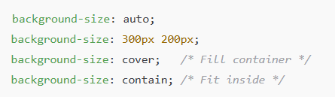
Sizing Backgrounds
First value: horizontal position
Second value: vertical position

Slide 53

Multiple Backgrounds
You can layer multiple backgrounds!

Slide 54
Accessibility Reminder
Don’t use background images for content users need to read or understand.
Screen readers don’t announce background images
Use <img> or semantic tags for important visuals

Slide 55
Summary and Reflection

Slide 56
Reflection Prompt
What is one key takeaway about colour contrast?
How will you ensure your designs are accessible?

Slide 57
Homework:
Complete homework exercise

